Slide 1
UNIT-3 Digital signatures
By
Dr.Ch.Sita Kumari

Slide 2
Content
Digital Signatures
Properties
Attacks and Forgeries
Digital Signatures Requirements
Direct Digital Signatures
ElGamal Digital Signature Scheme
Schnorr Digital Signature Scheme
NIST Digital Signature Algorithm
The DSA Approach
The Digital Signature Algorithm
Elliptic Curve Digital Signature Algorithm
Global Domain Parameters
Key Generation
Digital Signature Generation and Authentication

Slide 3
Introduction
Digital Signatures is a mathematical technique used to validate the authenticity and integrity of a message, software, or digital document.
Message digest is computed by applying hash function on the message and then message digest is encrypted using private key of sender to form the digital signature.
(digital signature = encryption (private key of sender, message digest)
message digest = message digest algorithm(message)).

Slide 4
Digital signature is then transmitted with the message.(message + digital signature is transmitted)
Receiver decrypts the digital signature using the public key of sender.(This assures authenticity, as only sender has his private key so only sender can encrypt using his private key which can thus be decrypted by sender’s public key).
The receiver now has the message digest.

Slide 5
The receiver can compute the message digest from the message .
The message digest computed by receiver and the message digest (got by decryption on digital signature) need to be same for ensuring integrity.

Slide 6
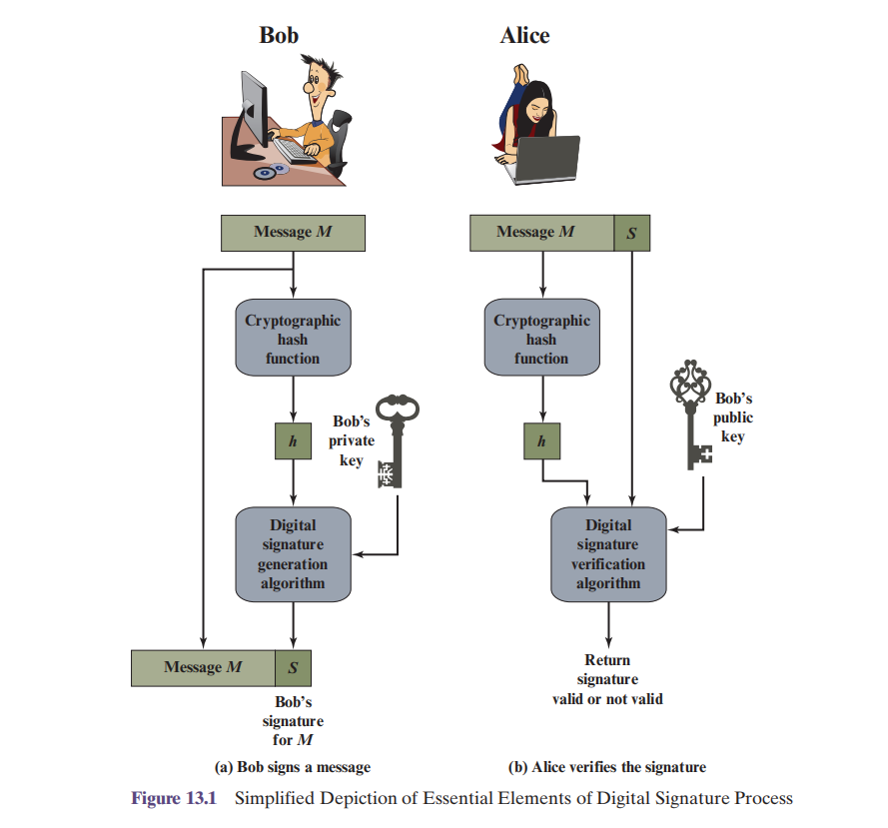

Slide 7
properties
It must verify the author and the date and time of the signature.
It must authenticate the contents at the time of the signature.
It must be verifiable by third parties, to resolve disputes.
Thus, the digital signature function includes the authentication function.

Slide 8
DS Requirements
On the basis of these properties, we can formulate the following requirements for a digital signature:
The signature must be a bit pattern that depends on the message being signed.
The signature must use some information unique to the sender, to prevent both forgery and denial.
It must be relatively easy to produce the digital signature.

Slide 9
It must be computationally infeasible to forge a digital signature, either by constructing a new message for an existing digital signature or by constructing a fraudulent digital signature for a given message.
It must be practical to retain a copy of the digital signature in storage.

Slide 10
Attacks on DS and Forgeries
Attacks and Forgeries:
A denotes the user whose signature method is being attacked, and C denotes the attacker.
Key-only attack: C only knows A’s public key.
Known message attack: C is given access to a set of messages and their signatures.
Generic chosen message attack: C chooses a list of messages before attempt_x0002_ing to breaks A’s signature scheme, independent of A’s public key. C then obtains from A valid signatures for the chosen messages. The attack is generic, because it does not depend on A’s public key; the same attack is used against everyone.

Slide 11
Directed chosen message attack: Similar to the generic attack, except that the list of messages to be signed is chosen after C knows A’s public key but before any signatures are seen.
Adaptive chosen message attack: C is allowed to use A as an “oracle.” This means that C may request from A signatures of messages that depend on
previously obtained message-signature pairs.

Slide 12
ELGAMAL DIGITAL SIGNATURE SCHEME
ElGamal encryption, the global elements of ElGamal digital signature are a prime number q and α, which is a primitive root of q.
User A generates a private/public key pair as follows.
1. Generate a random integer X_{A}, such that 1 <X_{A}< q - 1.
2. Compute Y_{A} = α^{XA} mod q.
3. A’s private key is X_{A}; A’s pubic key is {q, α, Y_{A}}.
To sign a message M, user A first computes the hash m = H(M), such that m is an integer in the range 0 <=m<= q - 1.

Slide 13
A then forms a digital signature as follows.
1. Choose a random integer K such that 0 <=K<= q - 1. and gcd(K, q - 1) = 1.That is, K is relatively prime to q - 1.
2. Compute S1 = α^{K} mod q.
3. Compute K⁻¹ mod (q - 1). That is, compute the inverse of
K modulo q - 1.
4. Compute S₂ = K⁻¹(m - X_{A}S₁) mod (q - 1).
5. The signature consists of the pair (S1, S2).
Any user B can verify the signature as follows.
1. Compute V1 = α^{m} mod q.
2. Compute V2 = (Y_{A})^{S1}(S₁)^{S2} mod q.
The signature is valid if V1 = V2.

Slide 14
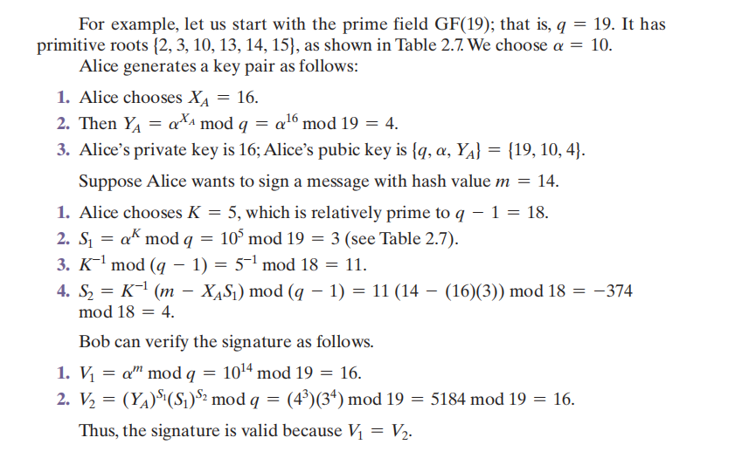
example

Slide 15
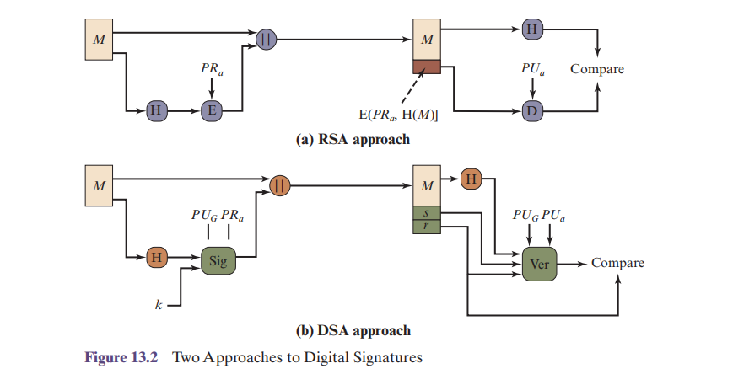
NIST Digital signture Algorithm
RSA Approach
DSA Approach

Slide 16
DSA cont...
Key Generation Algorithms
Signing Algorithm
Signature Verification Algorithms

Slide 17
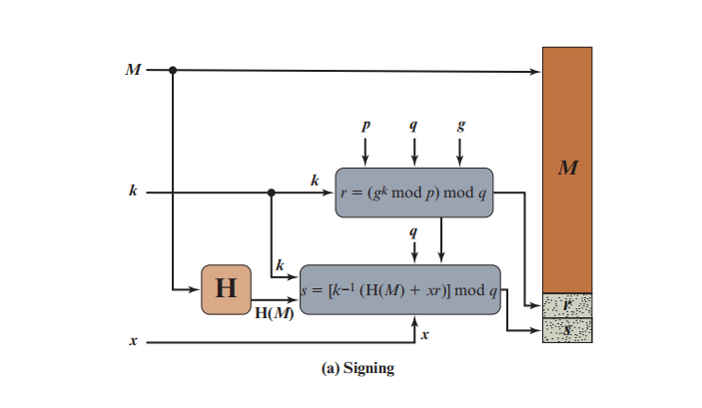
Signing Algorithm

Slide 18
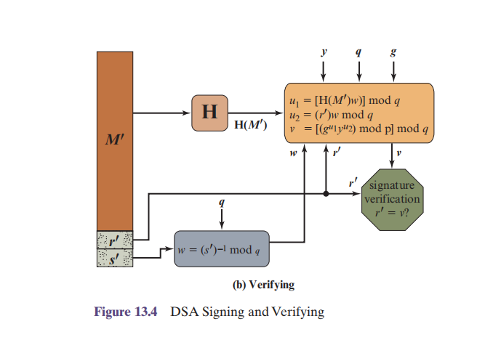
Verifying Algorithm

Slide 19
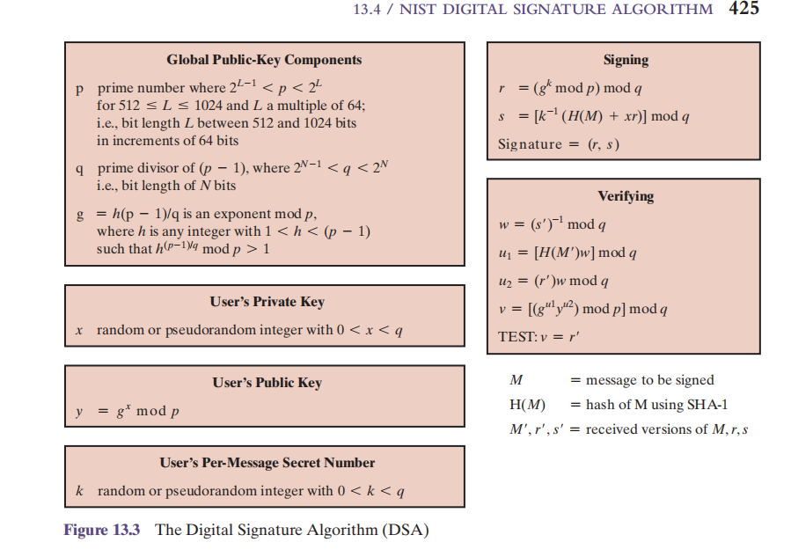

Slide 20
Elliptic Curve Digital Signature Algorithm (ECDSA).
1. All those participating in the digital signature scheme use the same global domain parameters, which define an elliptic curve and a point of origin on the curve.
2. A signer must first generate a public, private key pair. For the private key, the signer selects a random or pseudorandom number. Using that random number and the point of origin, the signer computes another point on the elliptic curve. This is the signer’s public key.

Slide 21
3.A hash value is generated for the message to be signed. Using the private key, the domain parameters, and the hash value, a signature is generated. The signature consists of two integers, r and s.
4. To verify the signature, the verifier uses as input the signer’s public key, the domain parameters, and the integer s. The output is a value v that is compared to r. The signature is verified if v = r.

Slide 22
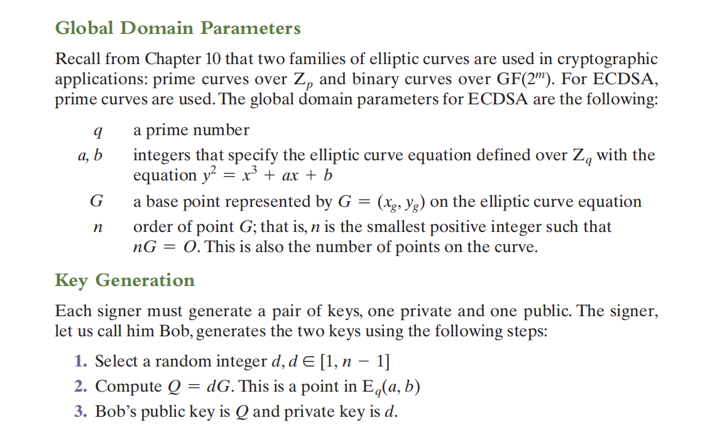

Slide 23
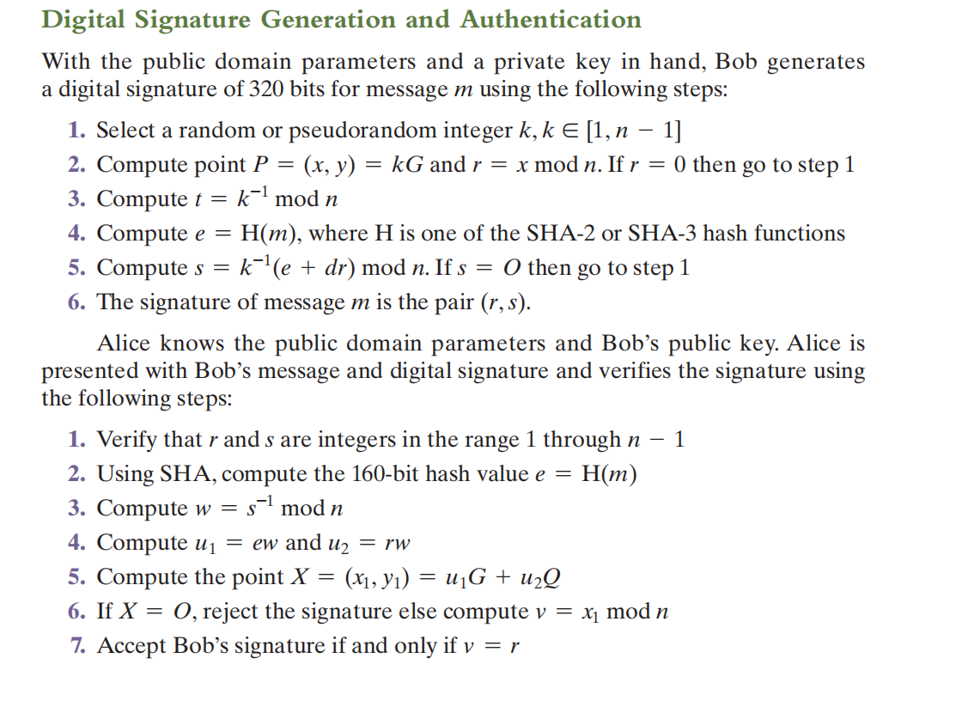

Slide 24
